Slide 1

Student_Management_System Using REST API
Project Mentor:
Pooja Mehta
Team Members:(BatchNo:2022-7471) ​
Mohammed Zeba
Challapuram Nikitha
Parnandhi Sravani
Medipally Anitha

Slide 2
CONTENTS
Introduction
Objectives
Project Category
Technologies Used
Required Specifications
Modules
Spring Annotations
Use Case Diagram
ER Diagram
Database Design
Postman Design
Postman Screenshot
MySQL Screenshot

Slide 3
INTRODUCTION
••
* Student Management system can handle all the detail about a student. The details include Student personal details, Academic Score details etc.
* The student management system is an automated version of manual Student Management System.

Slide 4
OBJECTIVES
1. Student Management System is a management information system for education establishments to manage student data.
2. It provide capabilities for registering students in course, admitting student, tracking student data, and maintaining their academic data.
3. Ensure data integrity, privacy, and security in an open-access environment.

Slide 5
PROJECT CATEGORY
1. It is a web based application.
2. Unlike traditional applications, it is accessible anytime, anywhere, via a PC with an internet connection.
3. It need lower requirements on the end user system and simplified architecture.

Slide 6
TECHNOLOGIES USED
Spring Boot
Postman
MySQL
Maven

Slide 7
REQUIRED SPECIFICATIONS
Hardware Configuration | Software Configuration
Operating system : Windows 10 | Software IDE : Spring Boot
Hard Disk : 1 Tb | Language : Java
RAM : 4 GB | Back End : MySQL, Server, Postman

Slide 8

MODULES
Entity
Repository
Service
Controller

Slide 9
SPRING ANNOTATIONS
@RestController - Then there's the @RestController annotation, a convenience syntax for @Controller and @ResponseBody together. This means that all the action methods in the marked class will return the JSON response.
@PathVariable("placeholderName") - Another common way to provide information to the backend is to encode it in the URL. Then you can use the @PathVariable("placeholderName") annotation to bring the values from the URL to the method arguments.
@Service - Mark a specialization of a @Component. It tells Spring that it's safe to manage them with more freedom than regular components. Remember, services have no encapsulated state.
@Autowired - To wire the application parts together, use the @Autowired on the fields, constructors, or methods in a component. Spring's dependency injection mechanism wires appropriate beans into the class members marked with @Autowired

Slide 10
SPRING ANNOTATIONS
@SpringBootApplication:It is a combination of three annotations @EnableAutoConfiguration,@ComponentScan, and @Configuration.
@GetMapping: It maps the HTTP GET requests on the specific handler method. It is used to create a web service endpoint that fetches It is used instead of using: @RequestMapping(method = RequestMethod.GET)
@PostMapping: It maps the HTTP POST requests on the specific handler method. It is used to create a web service endpoint that creates It is used instead of using: @RequestMapping(method = RequestMethod.POST)
@PutMapping: It maps the HTTP PUT requests on the specific handler method. It is used to create a web service endpoint that creates or updates It is used instead of using: @RequestMapping(method = RequestMethod.PUT)
@DeleteMapping: It maps the HTTP DELETE requests on the specific handler method. It is used to create a web service endpoint that deletes a resource. It is used instead of using: @RequestMapping(method = RequestMethod.DELETE)

Slide 11


USE CASE DIAGRAM
Login
Add Details
Edit Details
View Score card
Add/Edit
Score
Admin
Student Management System

Slide 12
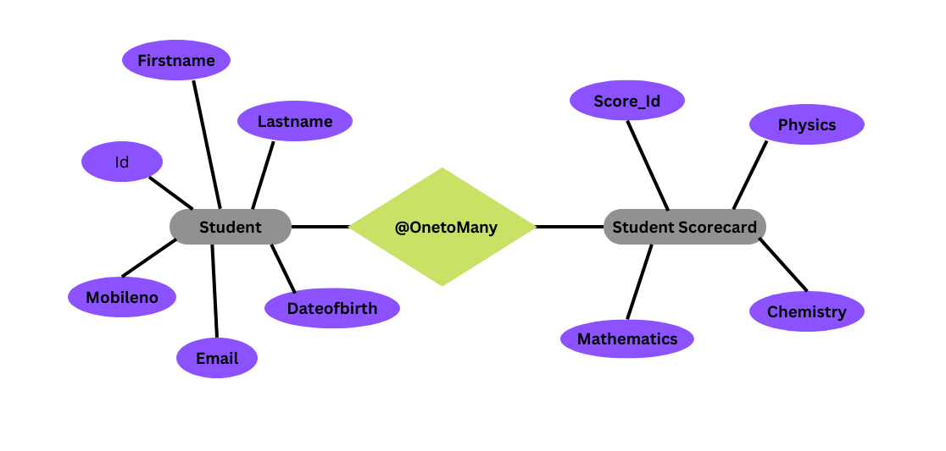
ER Diagram
Student Management System

Slide 13
DATABASE DESIGN
STUDENT TABLE :
Field Name : | Datatype : | Description :
Student Id | Int | Primary Key
First name | Varchar | Not Null
Lastname | Varchar | Not Null
DateOfBirth | Varchar | Not Null
Mobile No | Varchar | Not Null
Email | Varchar | Not Null

Slide 14
DATABASE DESIGN
STUDENTSCORE CARD TABLE :
Field Name : | Datatype : | Description :
Score Id | Int | Primary Key
Physics | Varchar | Not Null
Chemistry | Varchar | Not Null
Mathematics | Varchar | Not Null

Slide 15
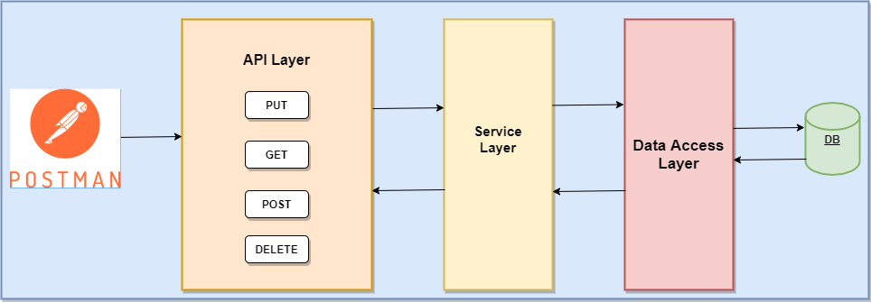
POSTMAN DESIGN

Slide 16
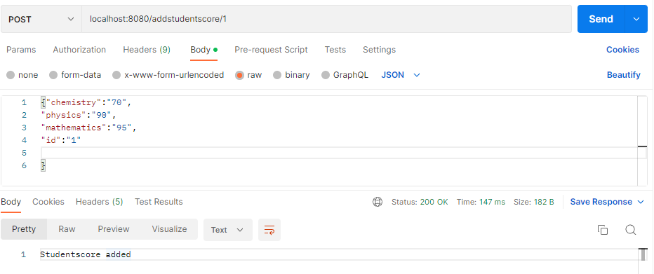
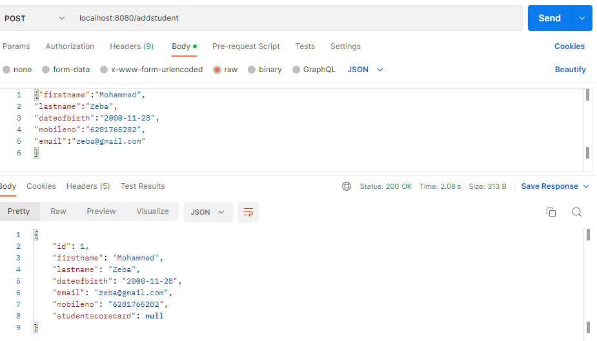
Postman Screenshot

Slide 17
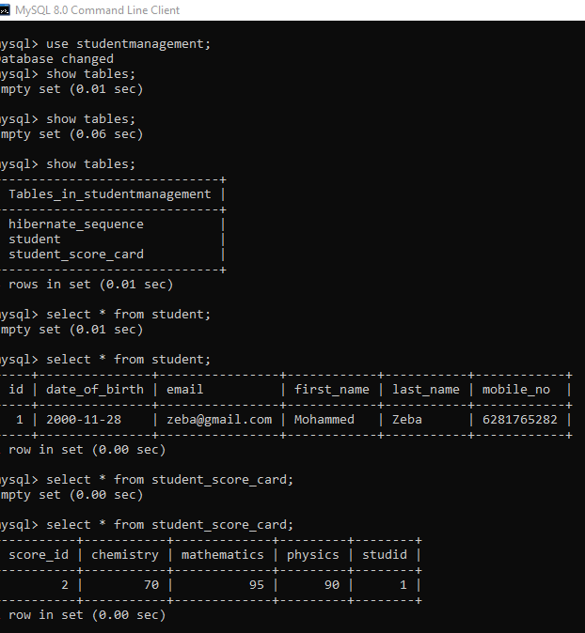
MySQL Screenshot

Slide 18
FUTURE SCOPE
>> In the future Student can also be able to upload or downloads the files
>> We will see the entire system more interactive and also be able to give statistics data.
>> We can run the entire system in any operating system

